Slide 1
Front End Web Development
Topic 11: Code Review and Testing. and Collaboration
Notes:
NCC Education - Title Master

Slide 2
Scope and Coverage
This topic will cover:
Webapp testing
SDLC
SDLC models
Version Control
Notes:
NCC Education - Slide Master

Slide 3
Learning Outcomes
By the end of this topic students will be able to:
Identify different test methods for front end web development
Develop and apply a test strategy consistent with the design
Describe the software development life cycle process and explain some of its models
Explain the concepts of Version Control and its significance

Slide 4
Unit Roadmap
Week | Topic | Week | Topic
1 | Overview of Web Application Architecture | 7 | JavaScript - II
2 | Introduction to HTML5 | 8 | jQuery
3 | Introduction to CSS | 9 | Responsive CSS Framework: Bootstrap
4 | HTML and CSS | 10 | AngularJS Web Development
5 | CSS Flexbox and Grid Layout | 11 | Code Review, Testing and Collaboration
6 | JavaScript - I | 12 | Unit Summary

Slide 5
Web app testing

Slide 6
What is Testing?
Testing:
Process of evaluating software with the intention of finding of errors (bugs)
Web Testing:
Collection of testing activities with the intention
to uncover errors in webapp content, function, usability, navigability, performance, capacity, and security.

Slide 7
Why Testing?
Testing is needed to identify errors.
In programming, errors are referred to as Bugs.
Often symptom of the error is seen, not the error itself.
Difficult or impossible to reproduce an error outside the environment in which the error was originally encountered.
Errors can be difficult to trace across three architectural layers: the client, the server, or the network itself.
Some errors are due to the static operating and others are attributable to the dynamic operating Environment.
Testing helps to identify the errors before it reaches end-user

Slide 8
Types of Web Testing
Testing is done in multiple stages and requires a plan.
Web Testing includes the following types:
Functionality Testing
Graphical User Interface Testing
Security Testing
Cross Browser/Compatibility Testing
Performance Testing
Usability Testing
Crowd Testing

Slide 9
Functionality Testing
Verifies whether the website is developed as per the functional requirements defined in the business documentation or not.
URL Testing/ Link Testing
URLs should be directed towards the appropriate webpage
No 404 error page or a broken URL
2) Form Testing/ Input Field Testing
All input fields tested by putting different types of characters and special characters
Appropriate error messages for mandatory fields, in case a user hasn’t filled those
3) Cookies Testing
Cookies are a small set of files used by a web application to store user sessions
Cookies should not store any vital information such as the CVV number of a card for banking transactions
4) End-to-End Workflow Testing
Workflow of the web application should be tested.

Slide 10
User Interface Testing
Graphical User Interface testing (GUI Testing) is testing for issues including:
Form truncation
Readable font
Appropriate color scheme
Proper adjustment of text in relation with the web page
Correct alignment and readable images and text, etc.

Slide 11
Security Testing
Security Testing is to identify/uncover any Security Loopholes (i.e., Vulnerabilities or Security Bugs).
Security Testing comprises of both Vulnerability Assessment and Penetration Testing.
Vulnerability Assessment assesses the application and identify the security loopholes (i.e. Vulnerabilities) in the application.
Penetration Testing simulates the hacker activities by hacking/breaching/utilizing the identified security loophole (i.e. vulnerability) to check or prove what kind of damage/risk that the vulnerability is causing.
Security Testing is a crucial aspect under web testing, especially for the sites such as banking, e-commerce.

Slide 12
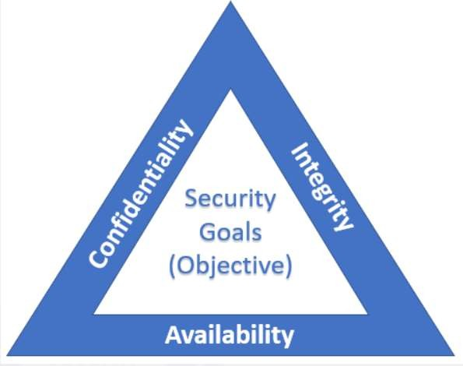
Security Testing
Objectives of Security Testing is to ensure:
Confidentiality –
Information is private and secured
Integrity –
accuracy and completeness of data & not tampered with.
Availability
Application/System is available all the time to the intended users.
CIA - Confidentiality, Integrity and Availability

Slide 13
Cross Browser Compatibility Testing
Web application is tested against different combinations of browsers and operating systems such as:
Firefox with Windows
Chrome with Windows
Safari with Mac OS
Intent of this testing is to verify that the web application behaves consistently across all OS’s and browsers wherein there should not be any browser or OS specific bug.

Slide 14
Performance Testing
Test the performance of the web application for different conditions
The response time of a web application and its behaviour during peak and non- peak load traffic
Recovery time of the web application when it crashes at a certain point of time
Several tools (commercial or open-source) are used for performance testing such as Loadrunner, JMeter, etc.

Slide 15
Usability Testing
Usability Testing pertains to testing the web elements such as:
Forms
Text boxes
Images
Menu items
Links
Usability testing ensures the consistency and visibility across all web pages.

Slide 16
Crowd Testing
Crowd Testing is also referred to as crowdsourced testing.
A large group of people are selected to perform testing on a web application.
Feedbacks and suggestions on the web application are collected.

Slide 17
Quiz - 1
1. Which type of testing focuses on a web application's performance under load?
A) Unit Testing
B) Load Testing
C) Usability Testing
2. What testing is performed to ensure that the web application is secure from external threats?
A) Security Testing
B) Integration Testing
C) Functionality Testing
3. Which testing ensures that a web application provides a good user experience and is easy to navigate?
A) Compatibility Testing
B) Usability Testing
C) Performance Testing
Notes:
Correct Answer: B) Load Testing
Correct Answer: A) Security Testing
Correct Answer: B) Usability Testing

Slide 18
SDLC

Slide 19
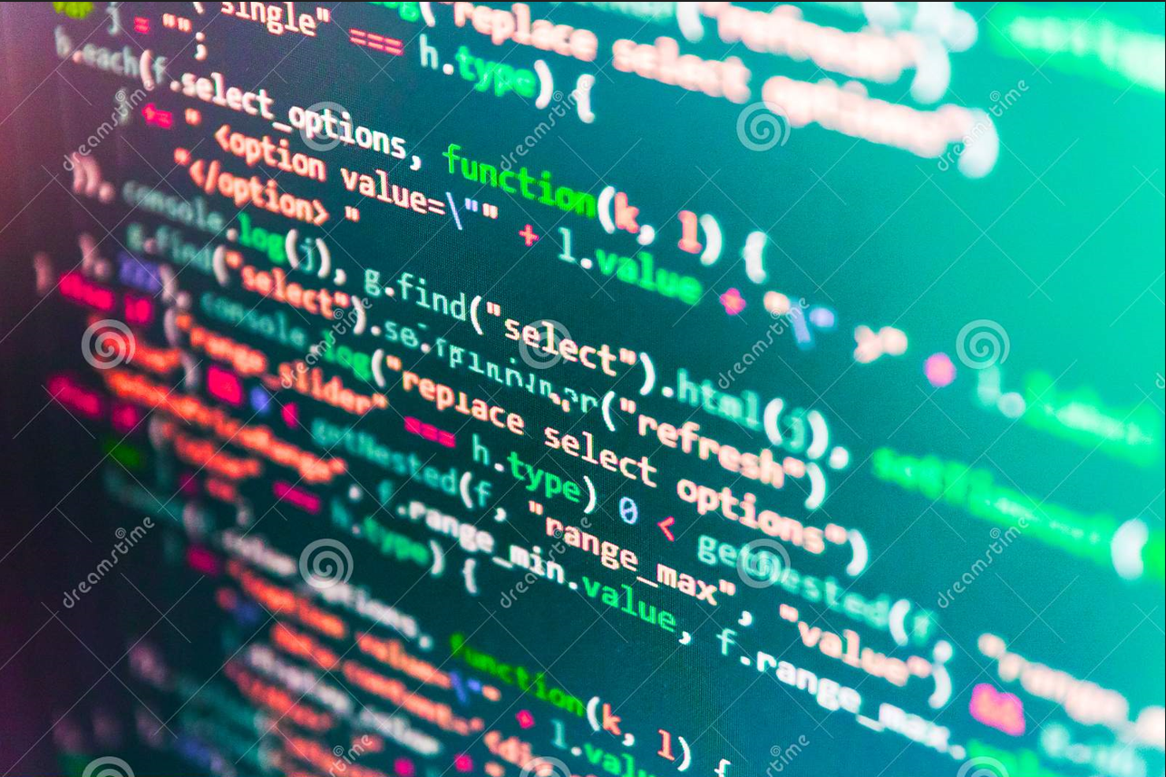
Software Development Life Cycle (SDLC)
Software development is not just about coding and programming languages.
Software development is a complex paradigm covering multiple aspects of a product that are required to synchronize for a fully functional, high-quality product.
It is essential that software development process is conducted in structured and quality-controlled environment.

Slide 20
SDLC Objectives
Defines a structured process for organizations to develop high-quality software products and the lowest cost possible.
Provides a framework of tasks to be performed at different stages of software development.
Essential for project planning, cost estimation and resource allocation.
Allows better control over project and the development process.
Defines roles and responsibilities for different stakeholders.
Goals for each stage including the expected output is pre-defined.
Improved communication between different stakeholders.
Decrease project risks, development and maintenance costs, and project management expenses

Slide 21
SDLC Phases
Requirements
Design
Development
Testing
Release & Maintenance
Planning
Typical phases of SDLC

Slide 22


SDLC Phases - Planning
Objectives:
Product roadmap
Cost estimation
Resource allocation
Capacity planning
Project scheduling
Collaborators:
Project managers (operations)
Development team manager
Product managers (Business analysts)
Outputs:
Project plan
Schedule
Cost estimates
Procurements
Product managers
Operations
Development

Slide 23
SDLC Phases - Requirements
Objectives:
Identify system requirements
Derive feature specifications
Design workflow
Comply with regulatory requirements
Approval
Collaborators:
Business analysis/product owners
Subject matter experts
Project manager (operations & development)
Architects
Outputs:
Specifications document
Define system inputs and outputs
System workflow
v.1.1
1. Introduction
Purpose, scope,..
2. Description
Summary, users, restrictions
3. Requirements
- functional
- non-functional
- performance
- interfaces, wireframes, etc.
Software requirements specifications

Slide 24
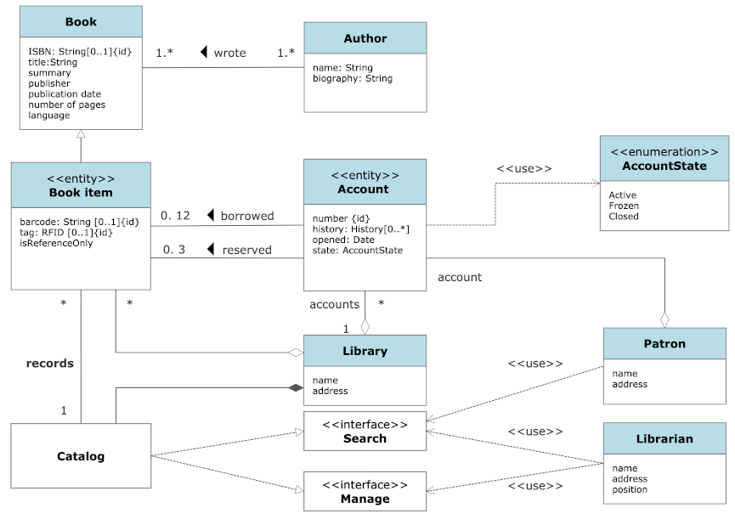
SDLC Phases - Design
Objectives:
Identify the technical requirements
Design the architecture of the software
Establish communication pattern between different components of the software
Rapid prototyping
Collaborators:
Software architects
Development team managers
Development team leads
Product owner / business analyst
Outputs:
Design Document
Prototypes
Development plan

Slide 25
SDLC Phases - Development
Objectives:
Software development
Implement features inline with requirements and design
Follow adopted methodology
Version control
Collaborators:
All development team
Business analyst / product owners
Outputs:
Developed software
Functional and testable

Slide 26




SDLC Phases - Testing
Objectives:
Test the software quality
Multi-level tests
Unit testing
Integration testing
Regression testing
Performance testing
Security testing
Acceptance testing
Collaborators:
Quality Assurance team
Developers
Outputs:
Identify “bugs”
Verify compliance to requirements
Test report

Slide 27



SDLC Phases – Release & Maintenance
Objectives:
Deploy the software
Regulatory approvals – UAT form
Release documentation and sign-off
Collaborators:
DevOps engineer/Release manager
Product owner
Project managers (operations)
Outputs:
Software in production
Release notes
Monitoring and maintenance
RELEASED!!

Slide 28
SDLC Phase – Task
Review the SDLC process of an organisation below and provide a quick description in own words.

Slide 29
Sdlc models

Slide 30
SDLC Models -Overview
Various models for SDLC
Each model defines a set of steps to follow for the development activity
Most popular models:
Waterfall
Iterative
Agile

Slide 31
SDLC Models – Waterfall
Waterfall:
Oldest SDLC model
SDLC phases in sequential manner
Tangible output in each stage
Little room for changes and flexibility
Expensive to make changes
Phase 1
Phase 2
Phase 3

Slide 32
SDLC Models - Iterative
Iterative:
Development in iterations
Subset of software requirements implemented
Final iteration completes the product
Allows parallel development
Phase 1
Phase 2
Phase 3
Phase 1
Phase 2
Phase 3
Requirements
Phase 1
Phase 2
Phase 3

Slide 33
SDLC Models - Agile
Agile SDLC is the most popular methodology for software development.
A combo of iterative and incremental process.
Provides a flexible framework.
Adaptive approach – does not require detailed planning.
Feature driven development approach.
Frequent testing resulting in low risks.
Release iterations.

Slide 34
SDLC Models - Agile
Development
Testing
Deploy
Requirements
Design
Development
Testing
Deploy
Requirements
Design
Development
Testing
Deploy
Requirements
Design
Sprint 1
Sprint 2
Sprint 3
Plan
Release
Release
Plan
Release
Plan
Under Agile methodology, the SDLC is carried out in short time durations called “Sprints”

Slide 35
SDLC Models - Agile
Agile manifesto:
Individuals and interactions over processes and tools
Working software over comprehensive documentation
Customer collaboration over contract negotiation
Responding to change over following a plan
Task
Read Agile Manifesto and twelve principles of Agile software at http://agilemanifesto.org/

Slide 36
Quiz - 2
1. What is a key characteristic of the Agile SDLC model?
A) Comprehensive documentation is prioritized over working software.
B) Development is carried out in small, incremental cycles.
C) Changes to requirements are discouraged late in the development process.
2. In Agile methodology, what is a short period during which a specific set of work has to be completed and made ready for review called?
A) Sprint
B) Waterfall
C) Phase
3. Which of the following best describes the role of a Scrum Master in an Agile team?
A) Directs team members on which tasks to complete each day.
B) Facilitates the team's progress towards their goals.
C) Writes the code necessary to implement new features.
Notes:
Correct Answer: B) Development is carried out in small, incremental cycles.
Correct Answer: A) Sprint
Correct Answer: B) Facilitates the team's progress towards their goals.

Slide 37
Version control

Slide 38
What is Version Control?
Version control is a system that records changes to a file or set of files over time.
You can recall specific versions later.
In coding, multiple versions of a code file are made.
Over time, it gets messy to manage the versions.
In collaboration, other developers have their own version of the code.
To manage the different versions and track the code development, version control is needed.
Version control can be managed by various commercial tools available.
Benefits include:
Generate backups
Test and experiment
Keep a track of changes
Collaborate and contribute

Slide 39
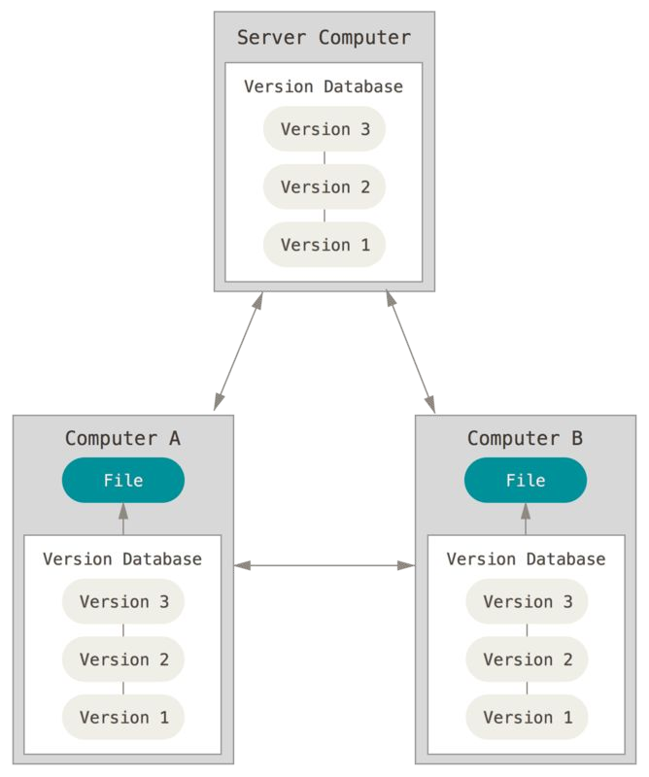
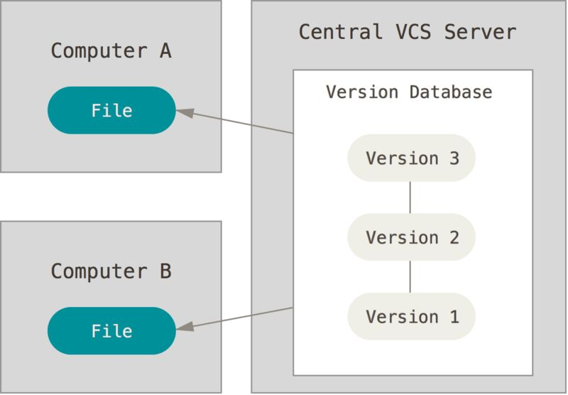
Types of Version Control System
Distributed VCS
Centralized VCS

Slide 40
Git Software
Git is free and open-source software for distributed version control.
It can track changes in any set of files.
Usually used for coordinating work among programmers collaboratively.

Slide 41
Git Commands
Common Git commands:
>> git add
>> git status
>> git commit
>> git log
>> git checkout
>> git revert
>> git reset

Slide 42
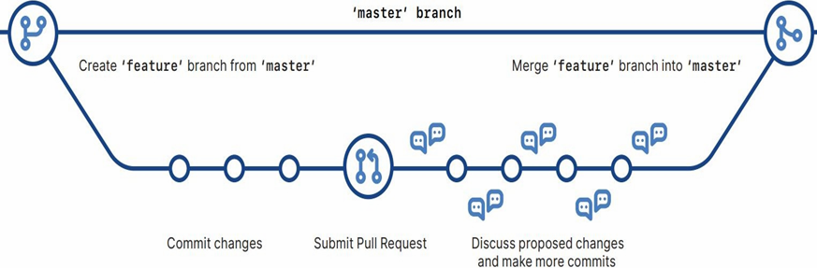
Branching in Git
With Git, main code can be separated from “in-development” code version
Master branch is a branch which holds the deployed code
With branching, different code versions can be held for development, testing, and production

Slide 43
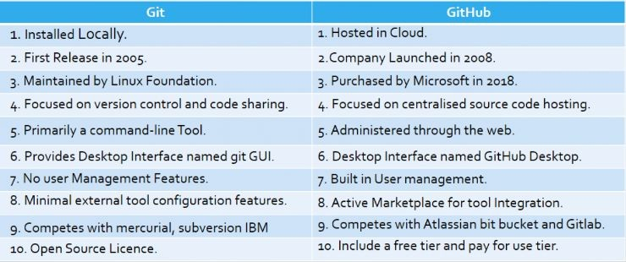
GitHub
GitHub is a website and cloud-based service that helps developers store and manage the code, track and control changes.

Slide 44
Project Collaboration with GitHub
Forking a repository.
“git clone”-ing a repository.
Working on new features in your local machine.
Updating the changes on your “local” repository.
Creating your ﬁrst pull request(PR).

Slide 45
Quiz - 3
1. What command is used to create a new repository in Git?
A) git start
B) git init
C) git create
2. Which command is used to clone a repository from GitHub to your local machine?
A) git clone [URL]
B) git copy [URL]
C) git get [URL]
3. How do you switch to a different branch in Git?
A) git checkout [branch-name]
B) git switch [branch-name]
C) Both A and B are correct.
Notes:
Correct Answer: B) git init
Correct Answer: A) git clone [URL]
Correct Answer: C) Both A and B are correct.

Slide 46
References
Books:
Web App Testing
Patton, R. (2014). Software Testing, 2nd Edition. Sams Publishing.
SDLC
Schwalbe, K. (2015). Information Technology Project Management, 8th Edition. Cengage Learning.
Version Control
Loeliger, J., & McCullough, M. (2012). Version Control with Git, 2nd Edition. O'Reilly Media.
Web Resources:
Webapp Testing
Guru99. Web Application Testing: Complete Guide How To Test A Website. Available at: https://www.guru99.com/web-application-testing.html
SDLC
Tutorialspoint. SDLC - Overview. Available at: https://www.tutorialspoint.com/sdlc/sdlc_overview.htm
SDLC Models
GeeksforGeeks. Software Development Life Cycle (SDLC). Available at: https://www.geeksforgeeks.org/software-development-life-cycle-sdlc/
Version Control
Atlassian. What is version control. Available at: https://www.atlassian.com/git/tutorials/what-is-version-control

Slide 47
Topic 11: Code Review, Testing and Collaboration
Any Questions?
Notes:
NCC Education - End Slide Master

